Slide 1

Hotel Booking Prediction
Discussion on Approach
May
2021

Slide 2

Problem Statement
Leverage Guest Data and Booking Behaviour Patterns to devise a strategy for Hotel Revenue Management, using Data Science and Machine Learning

Slide 3

Where to get the Data
Acknowledgement
The data is originally from the article Hotel Booking Demand Datasets, written by Nuno Antonio, Ana Almeida, and Luis Nunes for Data in Brief, Volume 22, February 2019
Data Source
Available on Kaggle
Uploaded to the following location on Google Drive:
https://drive.google.com/drive/u/0/folders/16xLtEIGKBLcrhBwi9QL1yQrwvYlgNt0l

Slide 4
Type of Given Datapoints
Market Segments
Offline vs Online sources from where the booking is generated and related variables
Hotel and Revenue
City or Resort Hotel, ADR etc
Customer Related
Variables describing the type of customer based on stay, whether returning, accompanied by how many etc
Cancellation History
Has their been cancellations made earlier? etc

Slide 5
Data Description
Variable | Description
hotel | Hotel (H1 = Resort Hotel or H2 = City Hotel)
is_canceled | Value indicating if the booking was canceled (1) or not (0)
lead_time | Number of days that elapsed between the entering date of the booking into the PMS and the arrival date
arrival_date_year | Year of arrival date
arrival_date_month | Month of arrival date
arrival_date_week_number | Week number of year for arrival date
arrival_date_day_of_month | Day of arrival date
stays_in_weekend_nights | Number of weekend nights (Saturday or Sunday) the guest stayed or booked to stay at the hote
stays_in_week_nights | Number of week-nights (Monday to Friday) the guest stayed or booked to stay at the hotel
adults | Number of adults
children | Count of Children
babies | Count of Babies
meal | Type of Preferred Meal
country | Country of Guest
market_segment | Booking Source
distribution_channel | Distribution Channel
Variable | Description
is_repeated_guest | Indicator Variable
previous_cancellations | Count of
previous_bookings_not_canceled | Count of
reserved_room_type | Type of Room
assigned_room_type | Type of Room
booking_changes | Count of
deposit_type | No Deposit / Refundable/ Non-Refundable
agent
company | Accompanied by
days_in_waiting_list | Days
customer_type | Type of Customer
adr | Average Daily Rate
required_car_parking_spaces | How Many cars needed to be parked
total_of_special_requests | Count of
reservation_status | Status
reservation_status_date | Date of Status

Slide 6

Business Questions
• Where do the guests come from?
• How much do guests pay for a room per night?
• How does the price per night vary over the year?
• Which are the most-busy month?
• How long do people stay at the hotels?
• Bookings by market segment
• How many bookings were cancelled?
• Which month have the highest number of cancelations?

Slide 7
EDA on Variables
Explore the pattens formed by the variables and try to draw insights from the inter variable relationships. Listed below are some key ideas that can be explored as a part of EDA
Examples
Do Cancellations differ by type of hotel?
Do Cancellation Rates have a time trend?
Where do the cancellation originate from? How do they differ by different Market Segments?
How does Lead Time and Average Daily Rate differ?
What is relationship between Lead Time and Cancellation Rate Relate to each other?

Slide 8
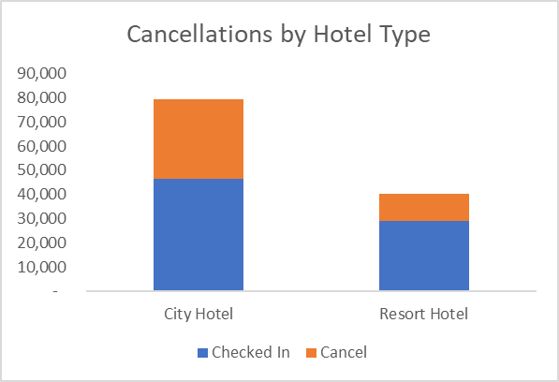
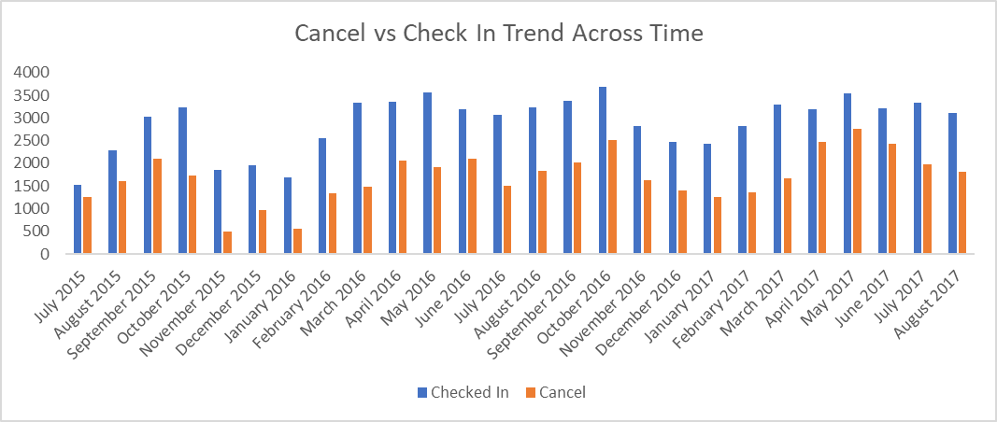

EDA – Part 1
Taking a look at the overall Cancellations and Arrival Date patterns
City Hotels have more cancellations than a Resort Hotel
Resort Hotel Cancellations – 11K
City Hotel Cancellations – 33K
Overall cancellation Rate – 37%
Cancellations typically reduces in the beginning of the year
The Absolute number of cancellations are increasing as time progresses
We may want to study the profile of cancellations from a source perspective

Slide 9
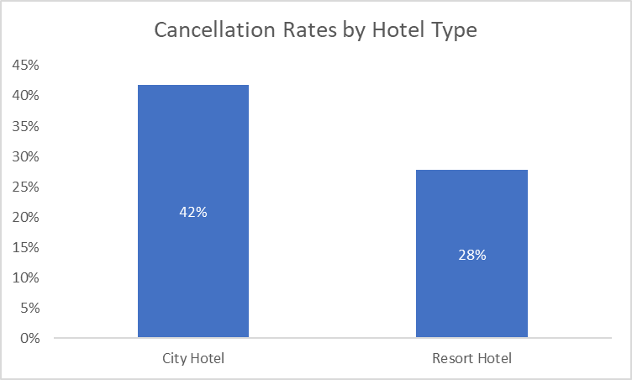
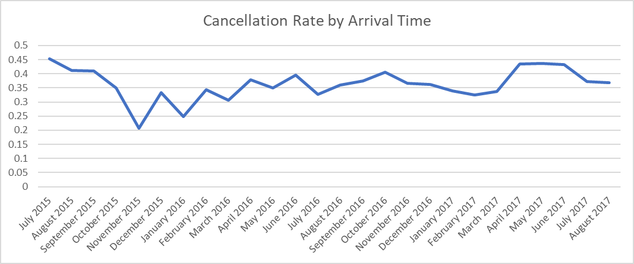
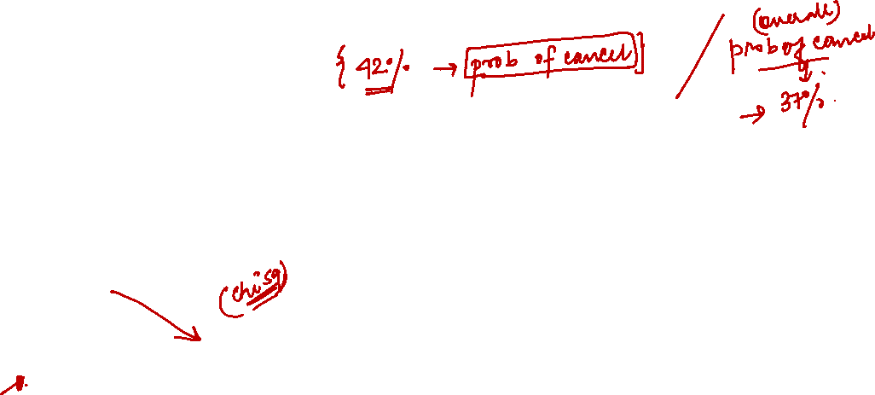
EDA – Part 2
Plotting the cancellation rate over time to uncover relationship between Arrival Time and likelihood to cancel
Baseline Cancellation Likelihood for City Hotels is 42%
The Baseline Cancellation Likelihood for Resort Hotel is 28%
More cancellations happen during Summer and Spring since there are generally more booking during that part of the year

Slide 10
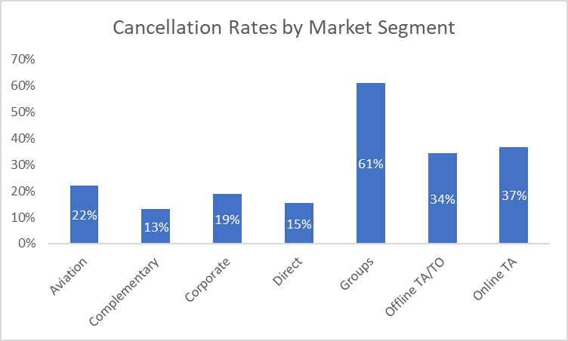
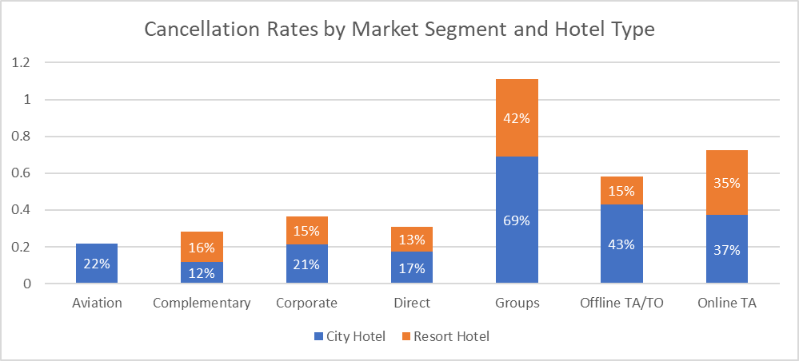
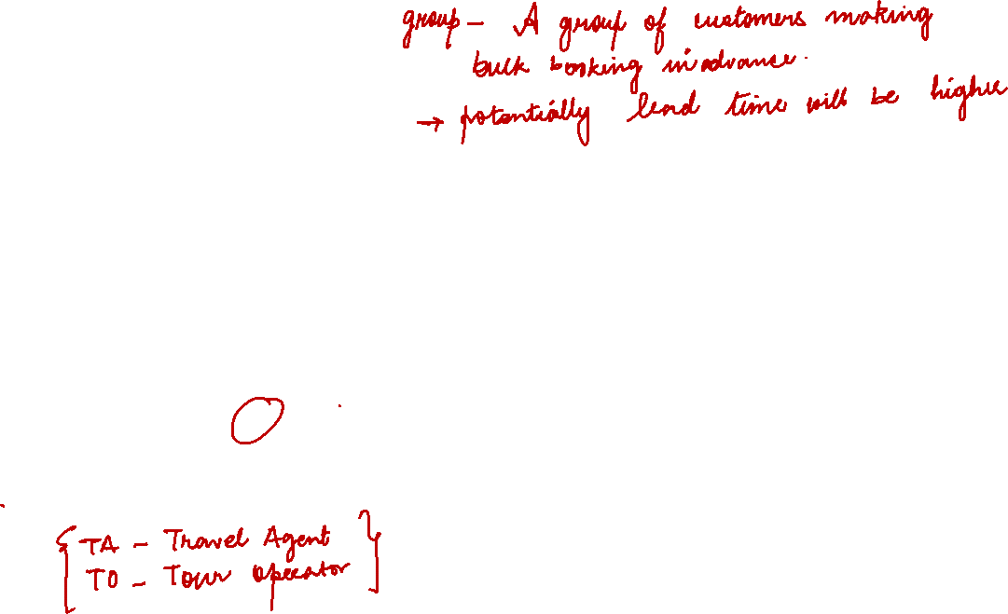
EDA – Part 3
Understanding Cancellations by Market Segment
Online, Offline TA and Groups lead the cancellations rate
The Hotel Type affects the cancellation rates

Slide 11
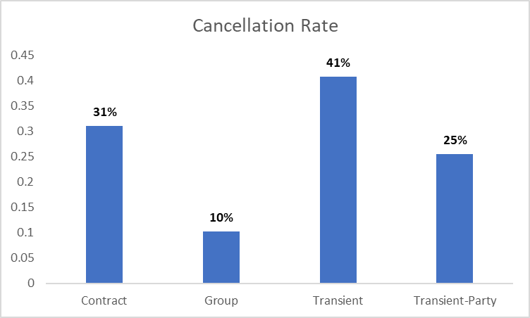
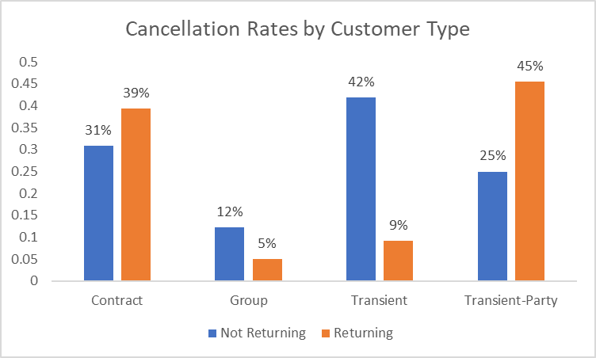
EDA – Part 4
Taking a look at the overall Cancellations and Arrival Date patterns
Transient Customers are more likely to make Cancellations City Hotel
Returning Customers are less Prone to make Cancellations
In fact they have opposing behaviour within Transient and Transient Party type of customers

Slide 12
Data Pre-Processing – Part 1
Dependent Variable - The cancellation of booking will be the dependent variable in our project
Modelling Hypotheses
We shall try to build separate models for Resort and City Hotels
Build indicator or One-Hot encoded variables that maximizes the discrimination
Explore Bi-variate relationships to check if specific pockets can be identified where likelihood capture maximizes
For Example – Returning Customers who belong to Transient Party Category
Treat the company variable and create some bins out of it. Interact the bins with the Customer Type and check for possibilities as described above
Build and engagement index of the booking to assess how deeply is the customer likely to embed in the hotel’s services

Slide 13
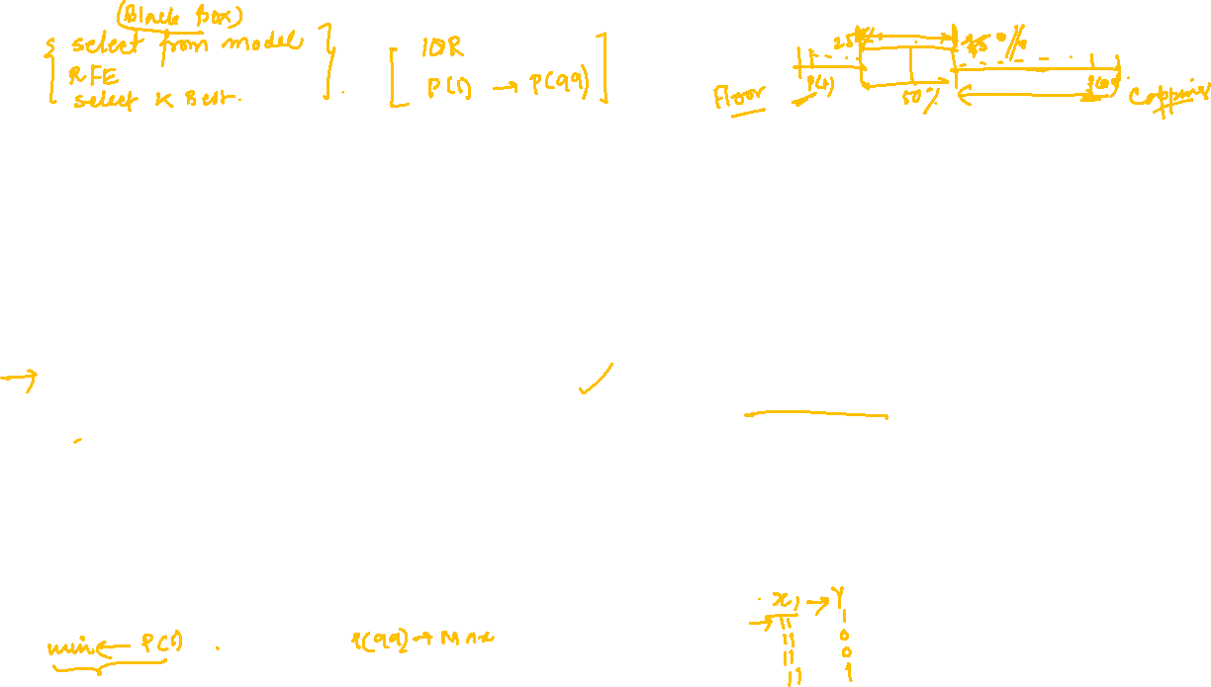
Data Pre-Processing – Part 2
Part 2 of Pre-Processing is divided into two steps – Derived Feature Creation and Fundamental Data Cleaning
Bivariate Rank Analysis
Variable Cleaning & Selection
Generate a percentile distribution of the variable
Collect extreme values lying beyond the (P1 to p99) range and create an outlier file
Divide the remaining values into deciles
Analyse the inactivity rate across deciles
Calculate Missing Value Percentage. Discard if feature has more than 25% missing value
Calculate Mean and Standard Deviation of Numerical Variables – Discard if Standard Deviation is 0
Discard the variables that do not show any discrimination across the Cancellation Rate

Slide 14
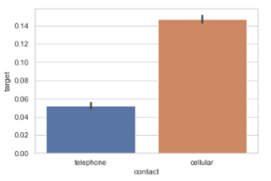
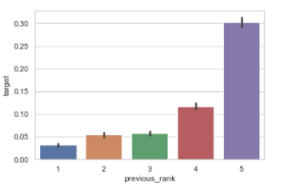
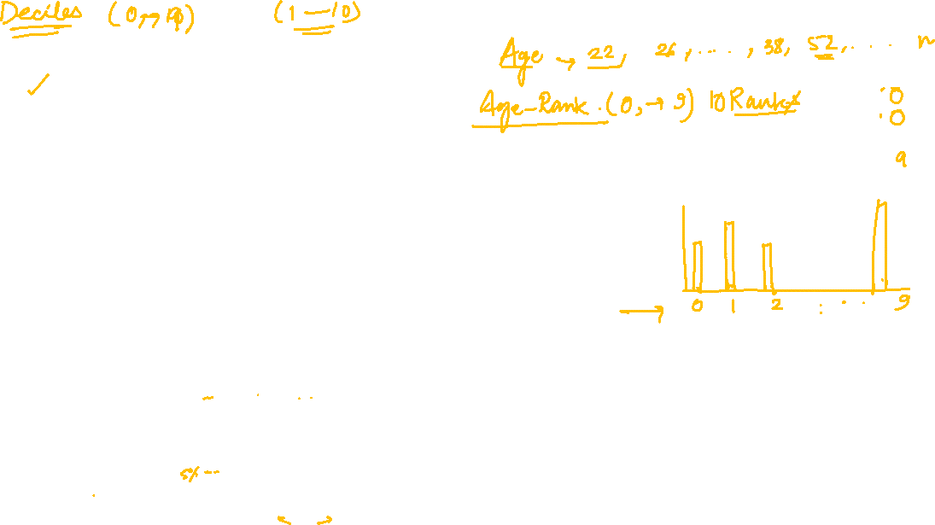
Bi-Variate Plots
Visualizations to reveal Bi-Variate data patterns and relationships
Plot Categorical Independent Variable Levels on X- Axis
Plot Average Value of Dependent Variable on Y-Axis
In case of Continuous Independent variable, break them into ranks and then plot them on the X-Axis
Avg Value of Y
Avg Value of Y
Categorical Independent Variable
Ranks of Continuous Variable

Slide 15
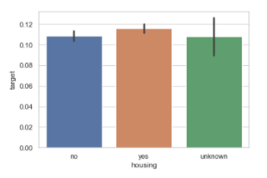
Insights : Bi-Variate Plots
We are looking for variables/features that differentiates the average value of Y
Based on plots we can determine which variables can predict Y
We can even group up some levels or club variable to achieve differentiation
Examples of good and bad outcome is given below to clearly explain the expectation
Bad Predictor
Good Predictor
Good Slope
No Slope
Avg Value of Y
Avg Value of Y
Categorical Independent Variable
Ranks of Continuous Variable

Slide 16
Classification Methodologies to Consider
Bi-directional approach : Strong classifier algorithms (Parametric and Non Parametric) can be tested and results compared for final deployment
Statistical Approach
Tree Based ML Algorithm
Logistic Regression
This model will have weights or coefficients for individual features
Flexibility to create custom target segment based on predicted probability for each client
Decision Tree and Random Forest
Generates a set of rules that can be visually interpreted and readily deployed for decision making
Captures interactions and non linearity in the data as predictors relate themselves to the dependent variable

Slide 17
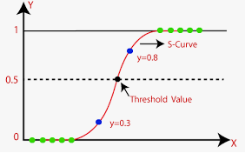
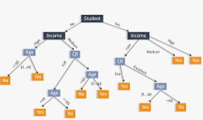

Classification Algorithms
Bi-directional approach : Both classifier algorithms (Statistical and ML Based) can be tried out and results compared for final deployment
Binomial LR Algorithm
Tree Based ML Algorithm

Slide 18


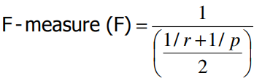
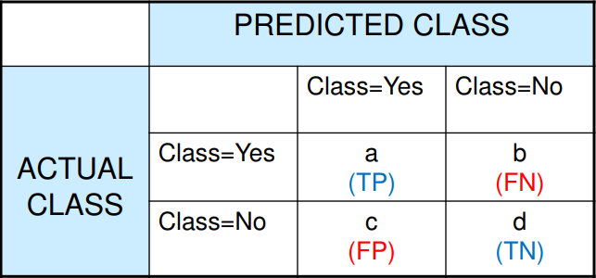



How to Measure Classification Performance
Accuracy
Precision
Recall
F Score
Confusion Matrix

Slide 19
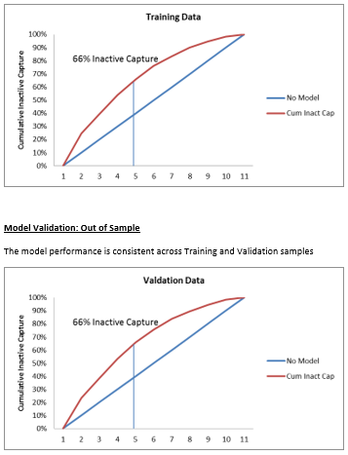
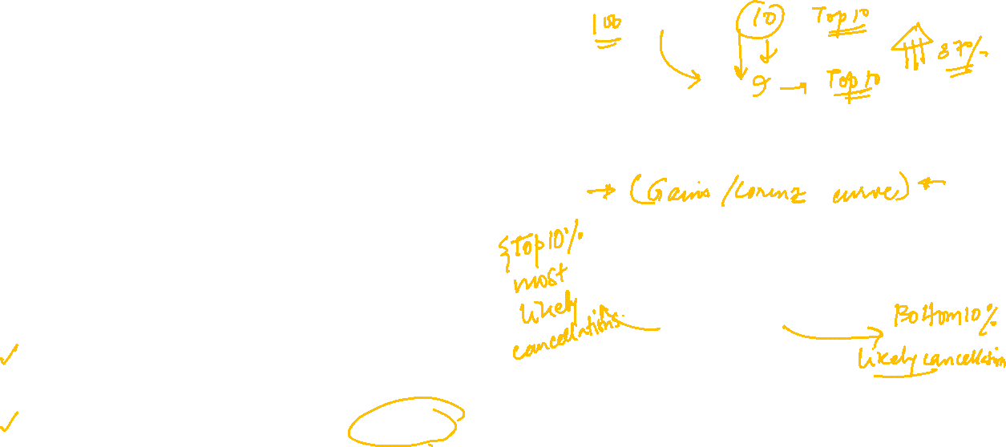
ML – Actionable Strategy
The outcome of the project is best conveyed with business context and impact
An Example of Strategy
City Hotel
Low Engagement
High Engagement
High Cancel Prob
Encourage to cancel soon
Lower Days to Cancel
Low Cancel Prob
No Action
Lower ADR
Resort

Slide 20

THANK YOU!
Aritra Kumar Sinha
Phone
+91 9650444155
Email
aritrakumar.sinha@gmail.com

